Slide 1
Design Patterns (Overview)
Source of most materials:
Xiwei Xu, Ingo Weber, and Mark Staples. Architecture for Blockchain Applications. Springer, 2019

Slide 2
What is a Design Pattern?
To solve a recurring problem in software development
Not a finished design that can be transformed directly into code
A description or template for how to solve a problem
Define constraints that restrict the roles of architectural elements
Processing
Connectors
Data
Define constraints that restrict the interaction among these elements
Causes trade-offs among quality attributes
Notes:
In software engineering, a design pattern is a general reusable solution to a commonly occurring problem in software design.
A design pattern is not a finished design that can be transformed directly into code.
It is a description or template for how to solve a problem that can be used in many different situations.
A design pattern defines constraints that restrict the roles of architectural elements (processing, connectors and data) and the interaction among those elements.
Adopting a design pattern causes trade-offs among quality attributes.

Slide 3
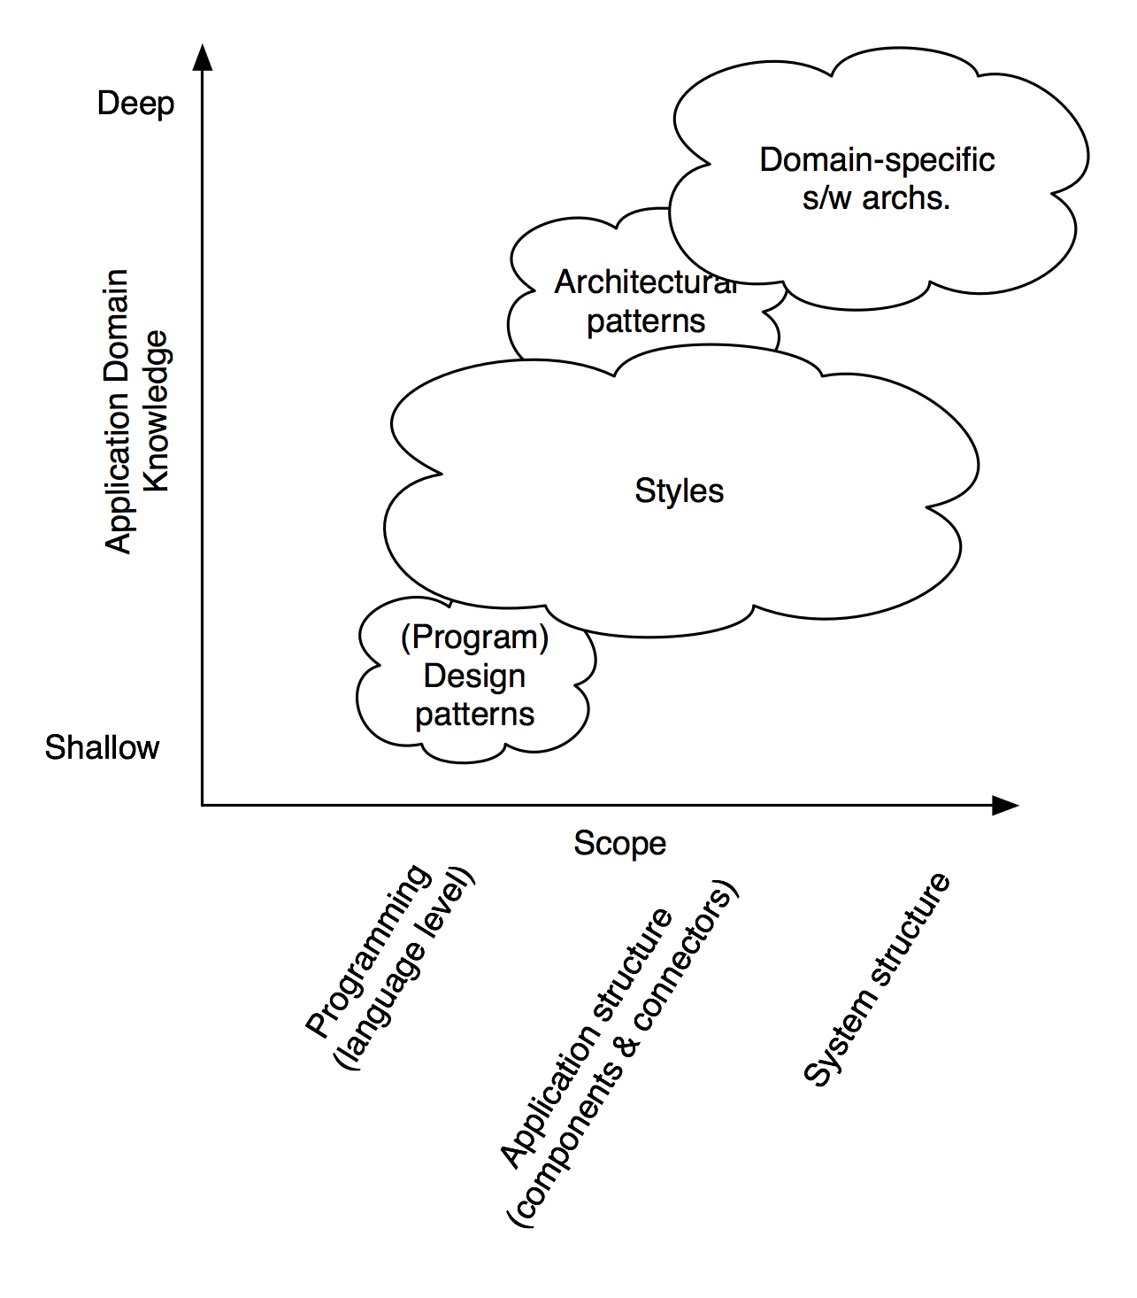
Architecture Design
From scratch
Unexpected solutions can be found
Labour-intensive and error-prone
Apply a generic solution/strategy (style/pattern) and adapt it to the problem
Reuse, less work and less errors
Generic solution might be ill-fitting or too generic
Software Architecture: Foundations, Theory, and Practice; Richard N. Taylor, Nenad Medvidovic, and Eric M. Dashofy; © 2008 John Wiley & Sons, Inc.
Notes:
There are two ways to design a software architecture.
One is from scratch, which is labour-intensive and error-prone, and the solution might not be optimal
The other way is to apply a more generic solution or strategy, like architectural style or architecture pattern, and adapt it to the problem, like we use libraries in programing.
Reusing existing design from others cause us less work and less errors.
The diagram gives two dimensions for classification of some architecture design concept.
X axis represents scope, which is from programming language level to the system structure level
Y axis represent application domain knowledge, which is from shallow to deep
The design patterns you perhaps familiar with is at language level and relatively shallow in terms of domain knowledge. Which means it is agnostic domain.
The range of architecture styles can be large, which covers language level, application structure and system structure.
Architecture patterns, on the other hand, is at application structure, which doesn’t give a system level structure.
Finally, the domain specific software architectures needs the deepest domain knowledge, and gives a system level design solution

Slide 4
Advantages of Patterns
Design patterns can speed up the development process by providing tested, proven development paradigms.
Design patterns document the efforts of the experts
Design patterns concerns with a flexible software architecture
Effective software design requires considering issues that may not become visible until later in the implementation.
Reusing design patterns helps to prevent subtle issues that can cause major problems and improves code readability for programmers and architects familiar with the patterns.
Notes:
There is no need to reinvent the wheel

Slide 5
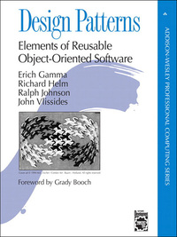
Gang of Four (GoF)
Classic Object Oriented Design Patterns
GoF are Erich Gamma, Richard Helm, Ralph Johnson and John Vissides
GoF document 23 classic software design patterns in their book
Design Patterns: Elements of Reusable Object-Oriented Software
The GoF book published in October 1994; documented design patterns that already existed but were not documented before
Notes:
The object oriented design patterns from Gang of Four are the most widely used design patterns
In the book design Patterns: elements of reusable object-oriented software, …

Slide 6



Student Task
Did you learn about GoF patterns?
Did you apply any of them?
If so: what are your experiences?

Slide 7
Four Essential Elements
Pattern Name
Describe a design problems, its solutions and consequences in a word or two
Problem
Explain the problem and its context
Conditions must be met
Solution
Describe the elements that make up the design
Consequence
Results and trade-offs of applying the pattern
Relationship, responsibilities, and collaborations
Critical for understanding the costs/benefits
Notes:
Four essential elements include name, problem, solution and consequence
pattern name is a handle we can use to describe a design problem, its solutions, and consequences in a word or two.
Name a pattern immediately increases our design vocabulary.
Having a vocabulary for patterns lets us talk about them with others
But Finding good names has been one of the hardest parts of developing a catalog.
The problem describes when to apply the pattern.
It explains the problem and its context.
Sometimes the problem will include a list of conditions that must be met before it makes sense to apply the pattern.
The solution describes the elements that make up the design, their relationships, responsibilities, and collaborations.
The solution doesn’t describe a particular concrete design or implementation, because a pattern is like a template that can be applied in many different situations.
Instead, the pattern provides an abstract description of a design problem and how a general arrangement of elements (classes and objects in our case) solves it.
The consequences are the results and trade-offs of applying the pattern.
they are critical for evaluating design alternatives and for understanding the costs and benefits of applying the pattern. The consequences for software often concern space and time trade-offs.

Slide 8
Non-Functional Properties
There are two kinds of requirements:
Functional Requirements (i.e. what are the inputs and outputs)
Non-Functional Requirements (a.k.a. Qualities, or –illities)
e.g. “Performance” (latency, throughput, … )
e.g. “Security” (confidentiality, integrity, availability, privacy, …)
e.g. Usability, Reliability, Modifiability, …
Non-Functional Properties arise from Architectural Design Choices
Notes:
Two kinds of requirements
FR: specify the behavior of system
NFR: specifies criteria that can be used to judge how well the system operates
With a fixed budget and timeframe, there is tradeoffs between non functional properties

Slide 9
ISO/IEC 25010:2011 Quality Model
Functional suitability
Functional correctness
Functional complete-ness
Performance efficiency
Capacity
Resource utilization
Functional appropriate-ness
Time behavior
Compatib-ility
Interop-erability
Co-existence
Usability
Operability
User error protection
Reliability
Availability
Recoverab-ility
Maturity
Fault tolerance
Security
Integrity
Confidential-ity
Non-repudiation
Accountab-ility
Authent-icity
Maintain-ability
Modularity
Reuseability
Modifiab-ility
Testability
Analyzab-ility
Portability
Installability
Replace-ability
Adaptability
Adopting a design pattern causes trade-offs among quality attributes
Notes:
International standards for evaluation of software quality
Blockchain has good and bad quality

Slide 10
Pattern Collection (Chapter 7)
Interaction with External World
Centralized Oracle
Decentralized Oracle
Data Management
Encrypting On-chain Data
Voting
Tokenisation
Security
Multiple Authorization
X-confirmation
Security Deposit
Contract Structural Patterns
Contract Registry
Embedded Permission
Data Contract
Factory Contract
Incentive Execution
Deployment
Semi-dapp
dapp
Legal and Smart Contract Pair
Reverse Oracle
Off-chain Data Storage
State Channel
Dynamic Authorization
Mixed on and off-chain
Purely on-chain
Notes:
Overview of pattern collections in five categories, including
On-chain and off-chain is the fundamental design decision
Oracles are offchain, legal and smart contract pair on chain
One by one discuss

Slide 11
Pattern Form
Pattern Form*
Pattern Name
Summary
Context
Problem Statement
Forces
Solution
Consequences
Real-world known uses
Benefits
Drawbacks
Related patterns
Forces
What makes the problem hard?
Identified with the quality attributes
Solution
Trade-off between the quality attributes
Features only applicable to certain type of blockchain, such as monetary cost
* Meszaros, G., et al.: A Pattern Language for Pattern Writing. Pattern languages of program design (1998)
Notes:
This is the structure of the pattern form or template we used to describe the blockchain application patterns. We use a extended pattern form from.
In addition to name, problem, solution and consequences, there are
a short summary, the context, an explicit discussion of the forces which make the problem difficult, related patterns, and some examples of real-world known uses of the pattern.
Forces are identified with the corresponding quality attribute, the solution will propose a trade-off between them.
Regarding the consequences, we distinguish the benefits and drawbacks.
Finally, we discuss features only applicable to a certain deployment of blockchain, such as monetary cost of data storage and code execution.

Slide 12
Context
Blockchain can be a component of a large(r) software system
Communicates with other components within the software system
Notes:
In this system, blockchain is responsible for storing and sharing data, and executing smart contracts.
The blockchain component might also have tokens as digital currencies or representing other assets.
Due to the limitations of privacy and performance, there are off-chain auxiliary databases used in the system.
First, private data is stored in an internal database.
Second, data with large size is stored in a separate data storage, which could be a cloud service.
There is a API layer between the data storage layer and the applications using the blockchain, which is same as with conventional technology.
Key management is an essential component working with blockchain.
Every participant in a blockchain network has one or more private keys, which are used by the participant to digitally sign the transactions relating to the addresses of the participant.
The security of these private keys is very important. If the private key of a user is stolen, any other user in the system can forge transactions from that user to spend the assets belonging to the user, invoke functions of smart contracts in their name.
Blockchain also interact with other off-chain components.

Slide 13
Pattern Collection (Chapter 7) Please read about the ones highlighted (black background)
Interaction with External World
Centralized Oracle
Decentralized Oracle
Data Management
Encrypting On-chain Data
Voting
Tokenisation
Security
Multiple Authorization
X-confirmation
Security Deposit
Contract Structural Patterns
Contract Registry
Embedded Permission
Data Contract
Factory Contract
Incentive Execution
Deployment
Semi-dapp
dapp
Legal and Smart Contract Pair
Reverse Oracle
Off-chain Data Storage
State Channel
Dynamic Authorization
Mixed on and off-chain
Purely on-chain
Notes:
Overview of pattern collections in five categories, including
On-chain and off-chain is the fundamental design decision
Oracles are offchain, legal and smart contract pair on chain
One by one discuss

Slide 14
Design Patterns (Overview)
Source of most materials:
Xiwei Xu, Ingo Weber, and Mark Staples. Architecture for Blockchain Applications. Springer, 2019

